Slide 1
Esther Memorial Oration

Slide 2
Mrs .Esther Navamani
11.11. 1921 -2001 Jan30 (Centenary year)
Mother of Prof .N.Hephzibah
She hail from village -Avudaiyanoor near curtallem of Thirunelvalli District
Studied in Govt School at the near by village,
then from Saratuker College – Palayankottai, Thirunelvalli
She was district level Netball player

Slide 3
Started her carrier as Mathematics teacher in Govt School
She was a passionate teacher and loved by her students
She was a dedicated , committed, approachable inspiring teacher
She had deep knowledge about her subject
Retired as Headmistress of Govt Higher Secondary School
Received Best teacher ( Nakaseeriar) Award from Tamil Nadu Govt

Slide 4
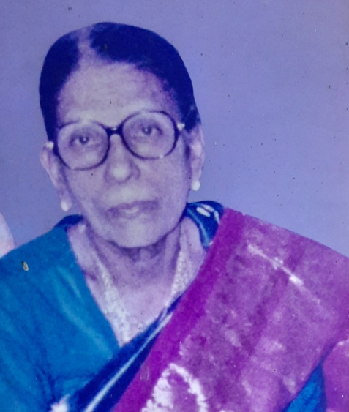
After retirement she was correspondent -All Saints Middle School – Mylapore – Which is a free School
Good home maker, involved in social activities and used to conduct bible quiz in Church
Written small book on prayer
She had played important role in lives of many poor students and shaped their life

